Slide 1


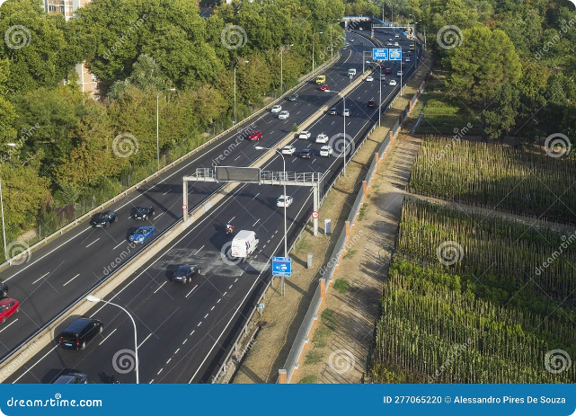
GPS-based Toll Collection System

Slide 2

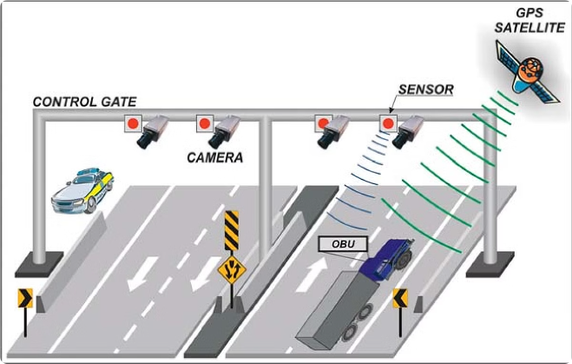
Unique Idea Brief (Solution)
This system eliminates the need for physical toll booths and manual payment processes. It also eliminates human error and provides a more seamless user experience.
1
Automated Toll Collection
2
Enhanced Efficiency
The system utilizes GPS technology to identify vehicles and track their location, enabling automated toll calculation and payment.
By eliminating the need for physical toll booths and manual transactions, the system streamlines the toll collection process and reduces traffic congestion.
3
Improved User Experience
4
Real-time Data Collection
The seamless automated system provides a more convenient and user-friendly experience, eliminating the need for cash transactions or physical toll booths.
The system gathers data about traffic flow and toll revenue, providing valuable insights for traffic management and infrastructure planning.

Slide 3
Benefits of GPS-based Toll Collection
The system offers several advantages over traditional toll collection methods, including improved efficiency, reduced traffic congestion, and increased revenue.
Increased Efficiency
Reduced Costs
Enhanced Security
The automated system eliminates the need for manual toll collection, streamlining the process and reducing wait times.
The system lowers operational costs by eliminating the need for toll booths, personnel, and manual payment processing.
The system enhances security by eliminating cash transactions and reducing the risk of fraud or theft.
Automated payment processing
Reduced traffic congestion
Lower maintenance costs
Secure data storage
Faster processing of vehicles
Reduced labor expenses
Reduced security risks
Improved traffic flow
Elimination of cash handling

Slide 4

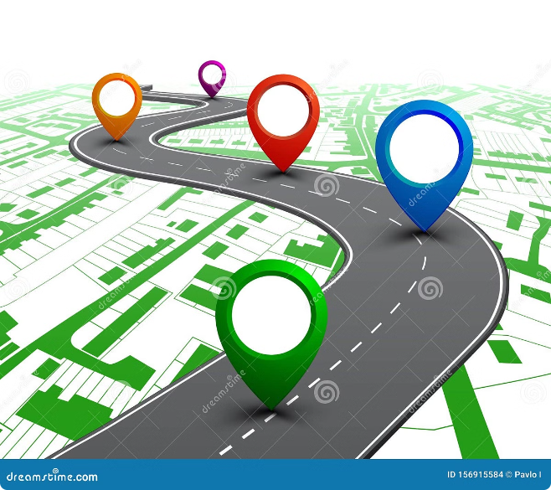



How GPS-based Toll Collection Works
The system operates by identifying vehicles using GPS technology, calculating the toll based on their route, and automatically deducting the payment from the user's account.
Vehicle Identification
The system utilizes GPS technology to identify vehicles and track their location in real time.
Toll Calculation
The toll amount is calculated based on the vehicle's route, distance traveled, and applicable toll rates.
Payment Processing
Payments are automatically deducted from the user's pre-registered account, eliminating the need for manual payment at toll booths.

Slide 5

Features Offered
This GPS-based toll collection system offers a range of features designed to enhance user experience and efficiency.
Real-time Toll Information
Automated Payment System
Users can access real-time toll information and route options before their journey, allowing them to plan their trips effectively.
The system automatically deducts toll payments from the user's account, eliminating the need for cash or manual transactions.
Real-time Distance calculation
Toll Reduction based on distance travelled
Use the real-time coordinate and previous coordinates to calculate distance travelled in small unit of time and is add continuously to give the total distance travelled.
Toll is deducted is based on amount of distance travelled on toll roads in specific Zones.Different zones have differnet per km tax.

Slide 6
Processflow
The process flow for the GPS-based toll collection system involves several steps, from vehicle identification to payment processing.
1
Vehicle Entry
As a vehicle enters the toll road, the system detects it using GPS technology.
2
Distance Calculation
The system start calculating distance travelled on toll road using the coordinates sent by the gps.
3
Payment Authorization
After the vehical exit the toll road the toll calculation is done and is deducted from user account.
4
Receipt Generation
A envoice is generated and stored in the server so the user can check it later.

Slide 7

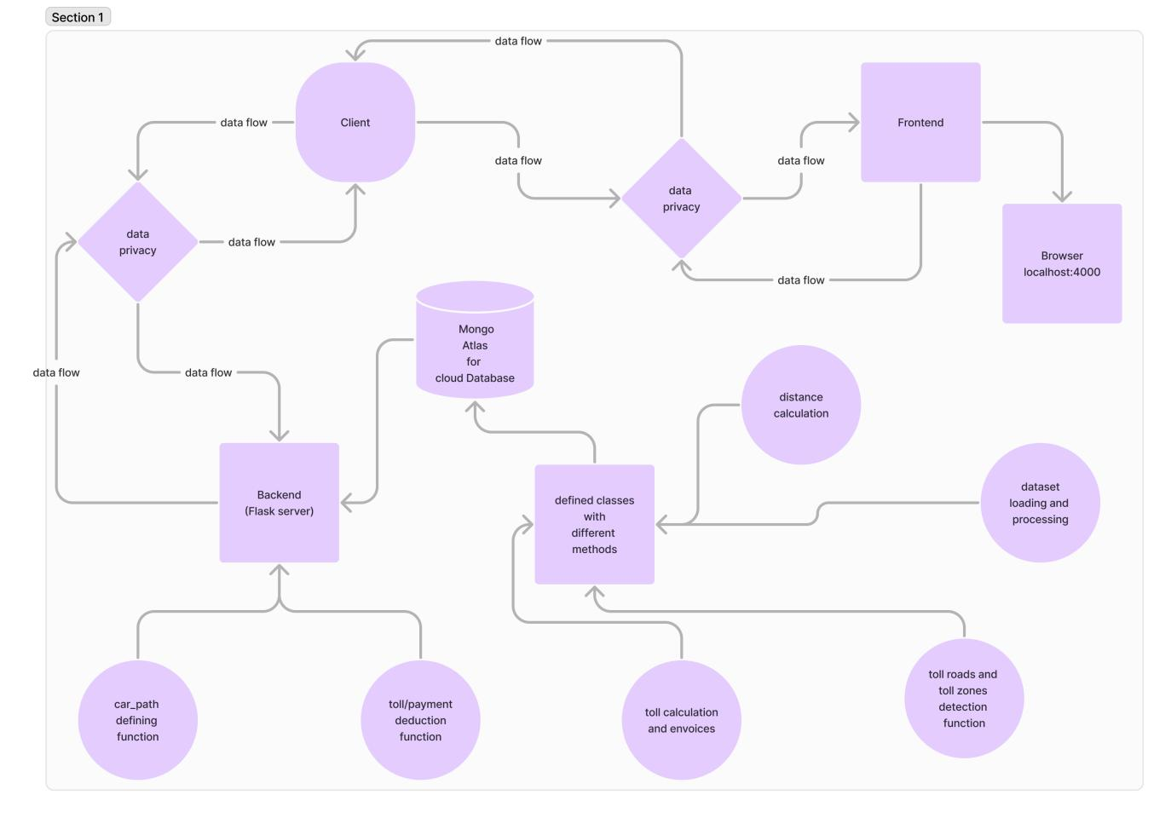
Architecture Diagram
The system architecture involves various components, including GPS receivers, servers, databases, and payment gateways.
Component
Description
GPS Coordinate Sender
Trace the path of vehical and send real time coordinates to server.
Flask Servers
Collect and process GPS data from vehicles.
Toll Calculation Engine
Calculates Distance using the coordinates.
Toll Calculation Engine
Calculates toll amounts based on
route, distance, and toll rates.

Slide 8
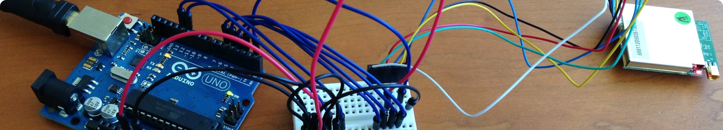




Technologies used
The system leverages a combination of technologies, including GPS, cloud computing, data analytics, and payment processing systems.
Cryptography
Python Classes
Database
GeoPandas and Shaply
To secure the receiving data from gps to server and to secure the payment process.
To organize the code in the proper structure and interconnectivity.
mogoDB Atlas is used for cloud database.It acts as the bank account of user
these modules were used to visualize and generalize the csv and geojson data.

Slide 9


Team Members and Contribution
A dedicated team of professionals with expertise in GPS technology, software development, data analytics, and payment processing collaborated to develop this system.
Team Member
Role
Contribution
Ansham Maurya
Backend
Real-time distance Calculation,flask server to collect the coordinates.
Toll Collection and payment Deduction from cloud database and database.
Ronit Singh
Backend
Data Analytics and data collection.Also Contributed in backend.
Ayush Mittal
Frontend
Map and data visulization.
Creating the gps simulation.
Gouransh agarwal
Frontend
Integrating Frontend and Backend.Securing the data using cryptography.
Suraj Kumar Gupta
Project Integrity

